Slide 1
Multiscale Modeling of Red Blood Cells Passing through the Human Spleen
Huijie Lu
Zhangli Peng
Department of Aerospace and Mechanical Engineering
University of Notre Dame

Slide 2
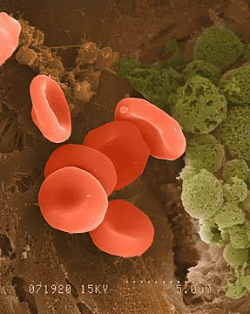
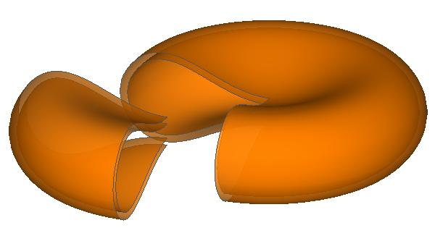
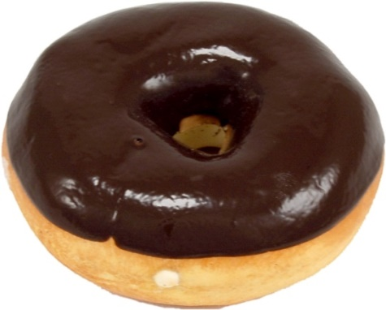
Why do we care about Red Blood Cells?
Carry oxygen by hemoglobin
Beautiful biconcave resting shape
Simplest but strong structure
Lack a nucleus
No complex organelles
Flexible and strong cell membrane
Beautiful Shape
Lipid bilayer
Cytoskeleton
Two-layer FEM model
(Peng et al. Physical Review E. 2010)
Notes:
The primary function of red blood cells is to deliver oxygen to the tissues and organs through blood flow (through the circulatory system). When it is at rest, it has a beautiful biconcave shape, like a donut. The interesting thing is that why it has such a beautiful donut-like shape is still a mystery. Still nobody knows the reason. Compare with other cells, RBCs have the simplest cell structure. Without a nucleus, RBCs have a liquid cytosol enclosed within a highly flexible yet surprisingly strong cell membrane.
Although the cell structure is very simple, but it is very strong to undergo large deformations. RBCs need to pass through narrow blood capillaries that are almost half their size. For example, a red blood cell with a diameter of 8um pass a slit in human spleen of only 0.5 um. In their life time of about 120 days, they need to squeeze through this type of slit millions times. However in many red blood cell diseases, their cell structure is not strong anymore. They may have trouble passing through this slit.

Slide 3
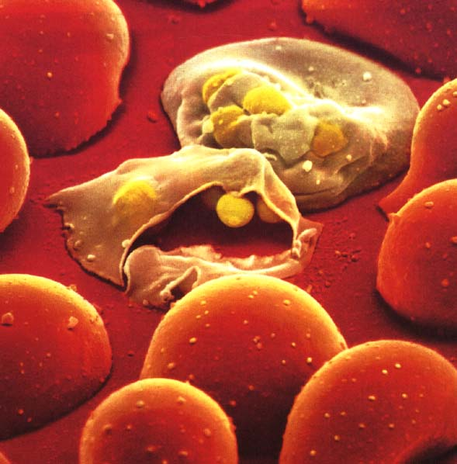
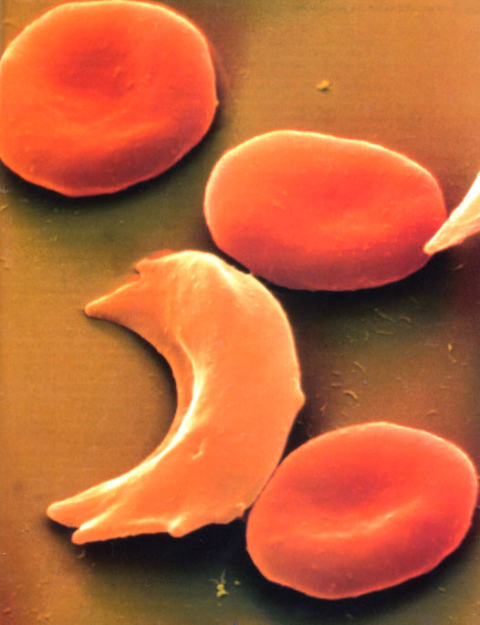
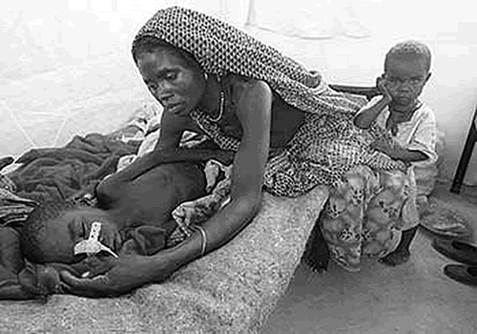
Red Blood Cell Diseases
More than 1 billion people (1 in 6) suffer from RBC diseases, e.g. malaria, anemia, sickle cell disease, (Mohandas et al. Blood 2008)
Malaria
Sickle cell disease
Anemia/Hereditary spherocytosis
1 million deaths per year in Africa
1 in 5000 in America
Diseases .vs. mechanical properties, structural stability of RBCs
Notes:
So another important reason to study red blood cells is to understand red blood cell diseases. There are more than 1 billion people in this world suffering from red blood cell diseases, e.g. malaria, anemia, sickle cell disease.
Many of these diseases are related to the mechanical properties and structure of the red blood cell. The malaria parasites invade the red blood cells and make them stiffer and stickier. In sickle cell disease, the cell becomes a sickled shape also stiffer and stickier. In hereditary spherocytosis, some protein deficiency changes the cell shape to be spherical, making it much harder to pass narrow capillaries. Even for a healthy red blood cell, its structure could be altered by mechanical loads.
So it is important to understand the relation between cell structure and mechanical loads. Since cell deformation and mechanical forces occur at different length scales, we develop a multiscale model of RBC.

Slide 4
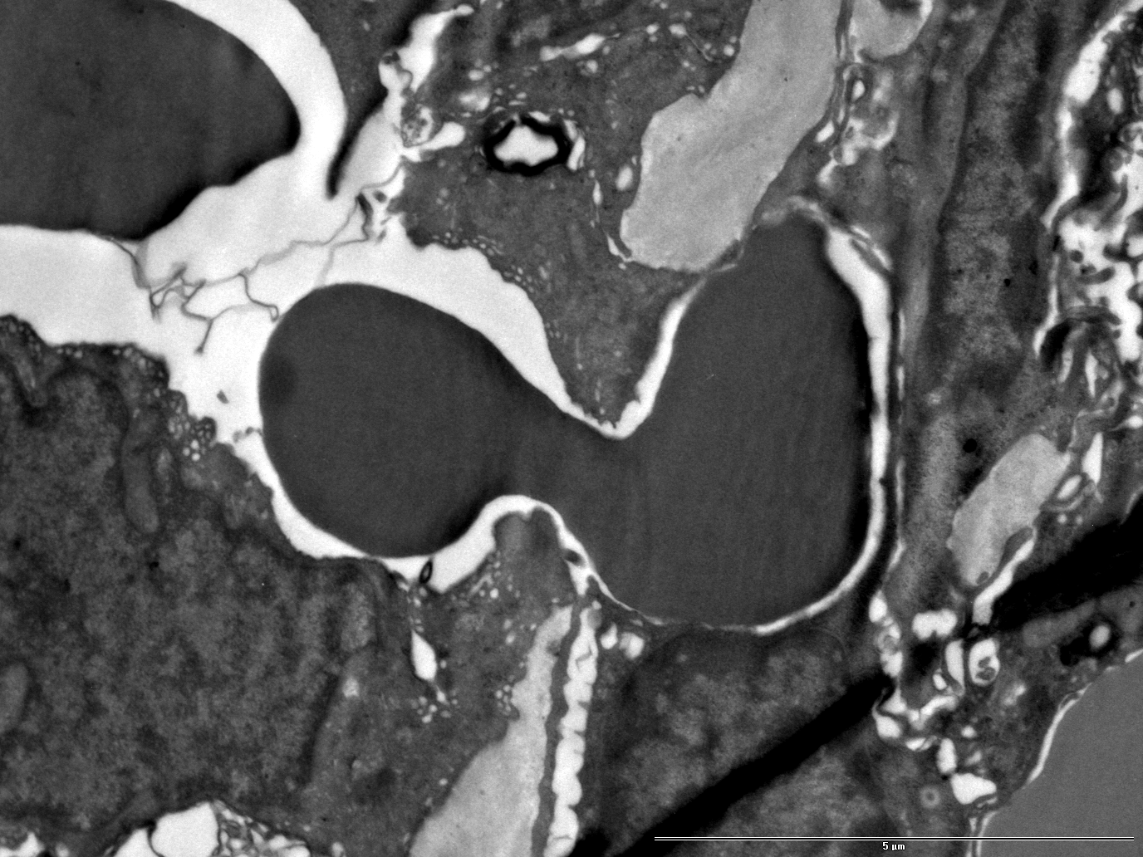
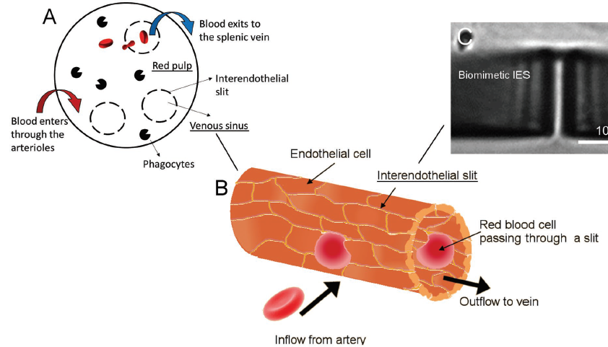

RBCs Transmigrating through Inter-endothelial Slits in the Human Spleen
Slit in human spleen
RBC
~0.5μm
Strong Structure (Buffet et al. Blood, 2011)
(P. Gambhire, A. Viallat et al.,
Small, 2017)
(P. Gambhire, A. Viallat et al., Small, 2017)
Notes:
The spleen is an vey important organ. It filters the old RBCs from the blood. A schematic of the blood filtration by the spleen is provided here. RBCs need to pass through the slits in the spleen and return to the circulation system. The width of the slits varied from 0.2-0.5um. But the diameter of RBC is about 8 um, they really need to deform largely to pass. The RBCs which cannot deform enough to pass are entrapped and destroyed. In red blood cell diseases, the mechanical properties and structural stability of the RBC are change, and they can’t deform enough then. Inspite of not very old, they are still removed from the circulation by the spleen.
Our microfluidic device has internal filtering channels of sub-micron size replicating the physiological dimensions of the IESs.
This on-chip biomimetic spleen is used to study the entrapment of RBCs. Slit dimensions: Width=0.835±0.03 µm, Length=1.93±0.03 µm and depth~5 µm.
The spleen is an organ of the lymphatic system which filters the senescent RBCs from the whole blood.
A schematic of the blood filtration by the spleen is provided here. The splenic arterioles end in the red pulp zone of the spleen which contains phagocytes and the venous sinuses of the splenic vein. The sinuses are lined with endothelial cells which have certain openings or slits called the interendothelial slits (IESs). The width of the IESs varied from 0.2-0.5um. Approximately 10% of the circulating blood passes through this open circulation zone of the spleen. The RBCs arrive through the arterioles and fill the red pulp. They are then pushed through the IESs on the sinuses and return to the circulation through the splenic vein. The RBCs which cannot deform enough to pass are entrapped and subsequently destroyed.
The deformability of the RBC is dependent on its high surface area to volume ratio, the interactions between the lipid membrane and the cytoskeleton and the rheological properties of its internal cytoplasm. In certain diseases such as hereditary spherocytosis, tha lassaemia and malaria, the mechanical properties of the RBC are affected causing a loss in its deformability. Inspite of not being senescent such cells are removed from the circulation by the spleen. This can potentially lead to enlargement of spleen and cause severe anemia. In other diseases such as the sickle cell disease, the adherent sickled cells lead to reduction splenic function.

Slide 5
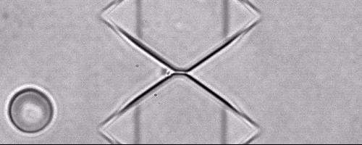
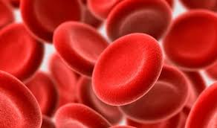
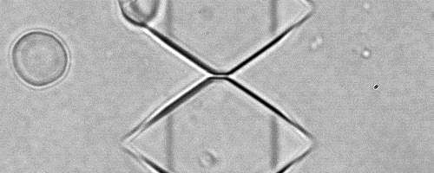

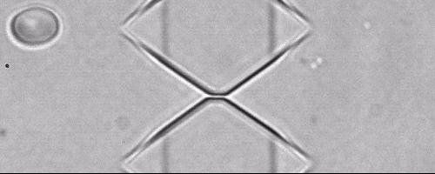
Experimental Work
Healthy RBC
Sickle cell
P. Gambhire, A. Viallat et al., Small, 2017
Anemia
Notes:
Professor Vialla Healthy RBC can also form a tip, but Scikle cell is much easier to form the tip
For H RBCs more than 90% cells transit through the slits.
For SCA RBCs, a similar trend is observed. But it shows higher percentage of cell shapes with tip at exit.
For HS RBCs, the percentage of entrapped cells (87%) is significantly higher than that of transiting cells. HS RBCs have a substantially high entrapment percentage when compared to the H RBCs.
The pronounced entrapment of HS RBCs can be explained based on their pathophysiology. To pass through the slit (volume of 8.05um3) the RBC (typical volume of 90um3) needs to undergo a large deformation. The abnormal membrane anchoring to the underlying spectrin network in HS RBCs leads to loss of membrane surface via vesiculation. This leads to an RBC with reduced surface area to volume ratio. When encountering a passage which is almost 10 times smaller than its internal volume the HS RBCs’lack of excess surface area prohibits any further deformation leading to entrapment.
Healthy cell: No tip, tip
Sickle cell: no tip, tip, elongated, irreversible
Spherocytosis cell: broken

Slide 6
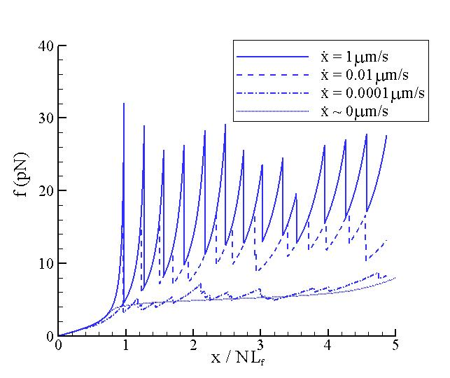
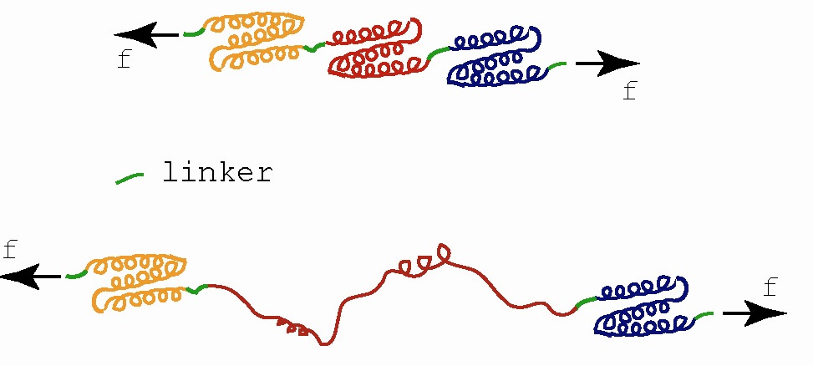
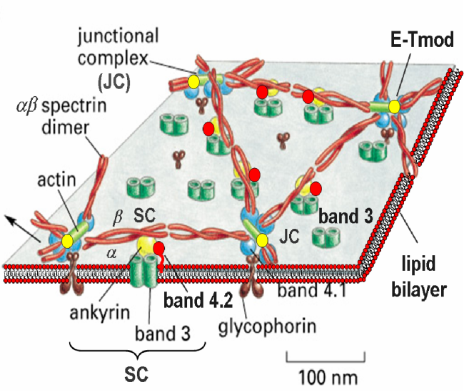
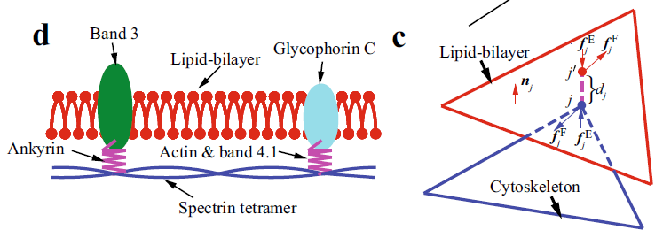
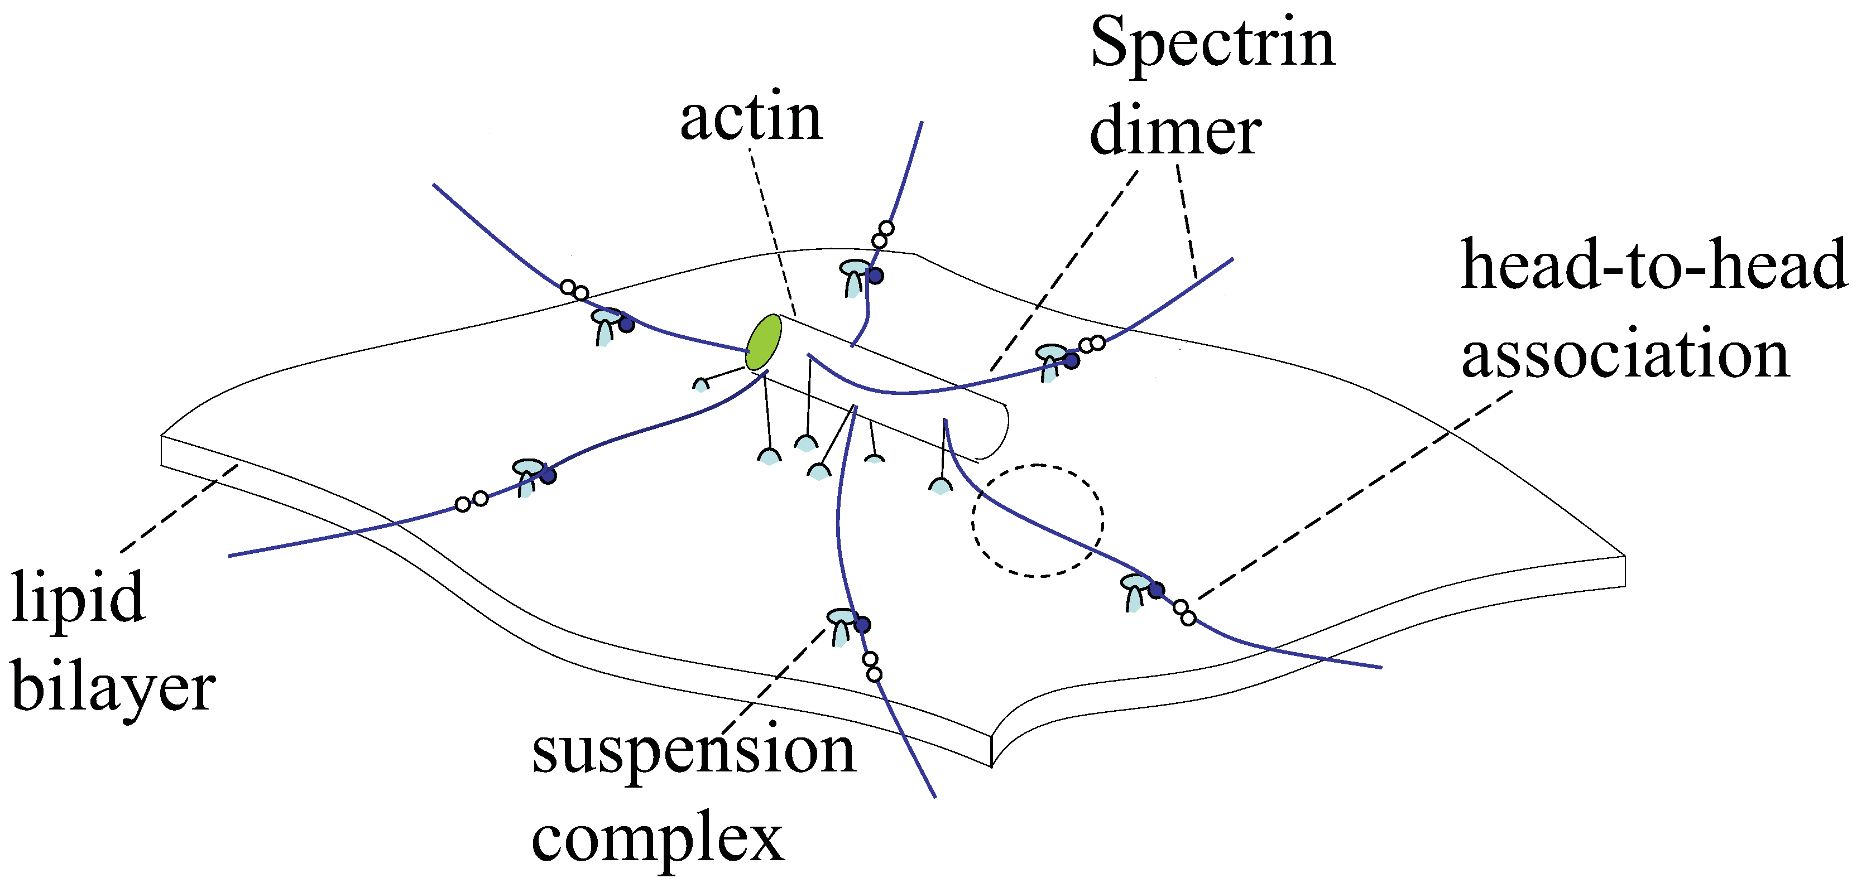
Three-level Hierarchical Multiscale RBC Models
Level I: Protein (Spectrin)
Force
Length of the protein
The unfolded domain of a spectrin (Self-protection)
Normal and tangential interactions between bilayer and cytoskeleton(Peng et al, Acta Mechanica Sinica. 2016)
Arrhenius equation using Monte Carlo method
(Alberts et al. Molecular Biology of the Cell)
(Zhu et al, Biophys. J. 2008)
(Alberts et al. Molecular Biology of the Cell)
(Zhu et al, Biophys. J. 2008)
Level II: Junctional Complex
Level III: Whole cell
Lipid bilayer
Cytoskeleton
Homogenization
e.g., Cauchy-Born rule
Two-layer FEM model
(Peng et al. Physical Review E. 2010)
(Zhu et al, Biophys. J. 2008)
Notes:
Each peak in the curve corresponds to one unfolding of the domain. The unfolding of spectrin domains is a thermal activated process.
The basic idea is although we cannot do MD for the whole cell, we can build different models at different length scales and find a way to connect them together. We have three models at three different length scales. For example, we have a protein model of spectrin. Spectrins are the red cables in the network. Here is a force-displacement curve when a spectrin is stretched by AFM. These drops are the unfoldings of the domains in the spectrin. We simulate this protein using Monte Carlo Method, we can not only get consistent response with experiment, but also can study how the curve changes with stretching speed by solving Arrhenius equation. It is rate-dependent. If we stretch it slower, the curve is smoother. Then we can pass these curves to our next level of model, which is a junctional complex model. Junctional complex is a protein unit surrounding the actin. Based on our collaborators’ work on molecular biology, we have the state-of-the-art understanding of this unit and how these proteins connect, where are the binding sites. Using Brownian Dynamics for the proteins and spectral method for the lipid bilayer, we can simulate the thermal fluctuation of this unit and also the mechanical properties. The blue cylinder is the actin and the black lines are the spectrins from previous model. Finally we can pass the information of the mechanical response of this unit, like how strain energy changes with deformation to our whole cell finite element model. In this level, the lipid bilayer and the cytoskeleton are modeled as two distinct layers using shell elements. They contact with each other and have different interaction forces.

Slide 7
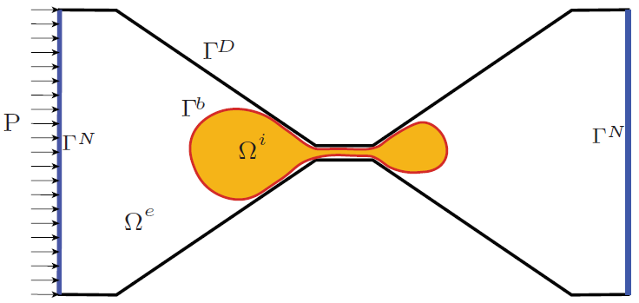
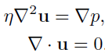
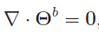
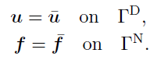
Boundary Integral Formulation of Elastic Capsules in Stokes Flow
Stokes Flow:
Boundary Element Method
Lipid Bilayer:
Finite Element Method
Boundary Conditions:
7

Slide 8
Numerical Challenges in Boundary Integral Method of this Complex Channel
Neumann boundary condition correctly handled
Nearly singular integral for lubrication
Sharp corner singularities
How to resolve these three problems

Slide 9
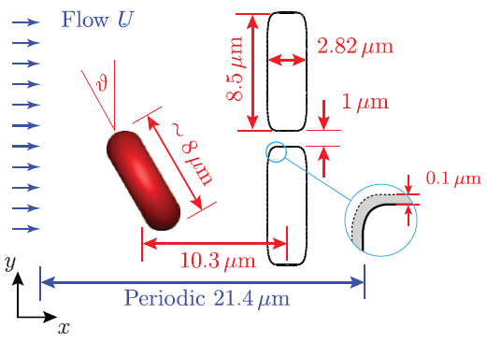
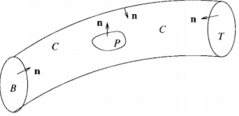
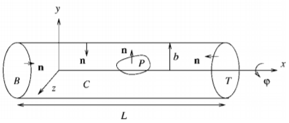
Dirichlet Boundary Condition
(C. Pozrikidis, Ann Biomed Eng, 2005)
(Jonathan B. Freund, Phys. Fluids, 2013)
Boundary integral equation for the fluid velocity
Notes:
But in many microfluidic experiments, they control the pressure drop between the inlet and outlet.
Even flow rate is controlled, the local pressure is usually constant.
Physiologically, pressure drop is constant.
Velocity on the Neumann boundary is unknow and it greatly affect the velocity in the flow field, so we need to solve the velocity
On the Neumann boundary (inlet/outlet) first.

Slide 10
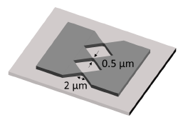
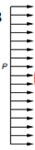
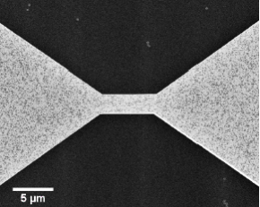

Neumann Boundary Condition
Microfluidic device
(P. Gambhire, A. Viallat et al., Small, 2017)
Numerical Simulation Model
Boundary integral equation for the fluid velocity
Velocity on Neumann Boundary
Notes:
But in many microfluidic experiments, they control the pressure drop between the inlet and outlet.
Even flow rate is controlled, the local pressure is usually constant.
Physiologically, pressure drop is constant.
Velocity on the Neumann boundary is unknow and it greatly affect the velocity in the flow field, so we need to solve the velocity
On the Neumann boundary (inlet/outlet) first.

Slide 11
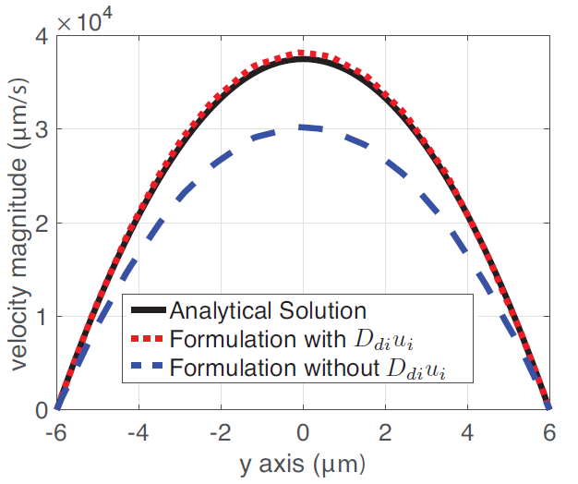
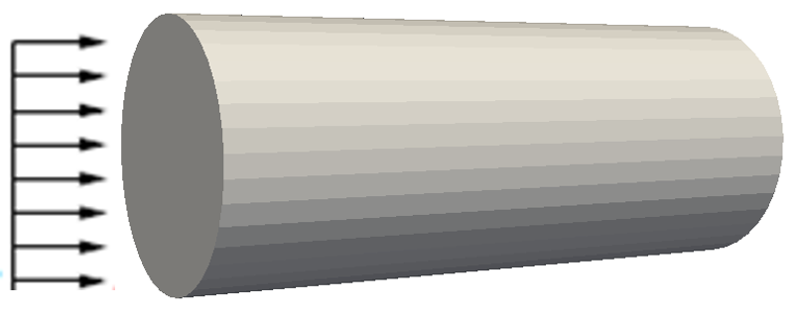
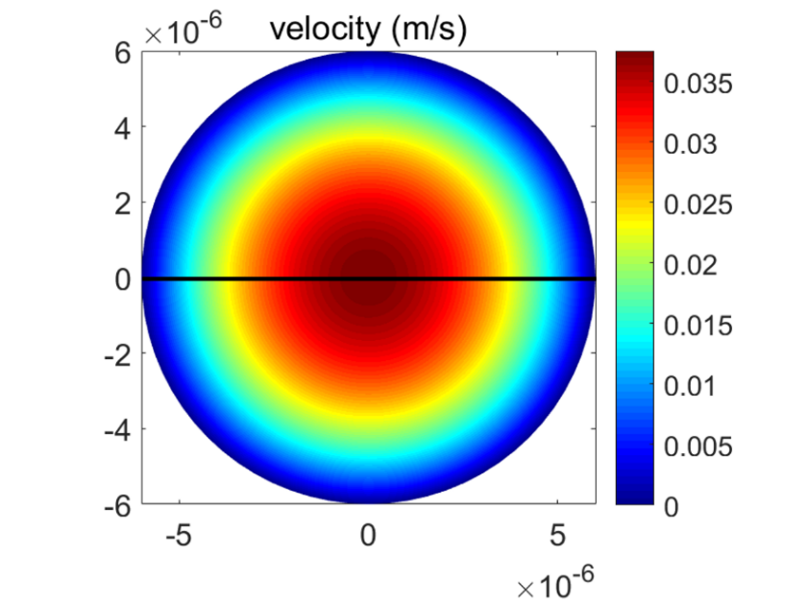
Validation of the Boundary Integral Formulation with Prescribed Pressure by Poiseuille Flow
z
P
0
y
x
Velocity on Neumann Boundary
Notes:
Velocity on the inlet/outlet is known and affect the fluid velocity in the flow field, so it needs to be solved first.

Slide 12
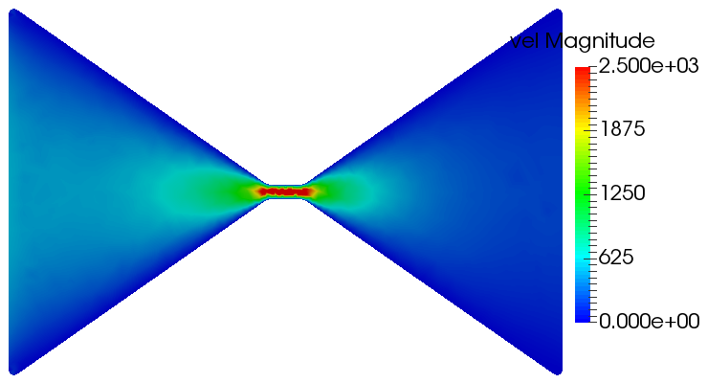
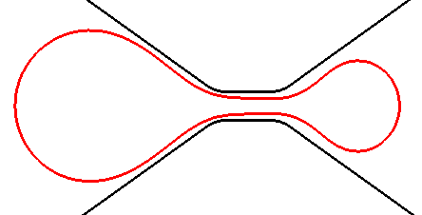
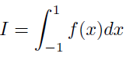
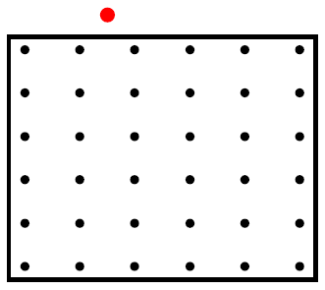
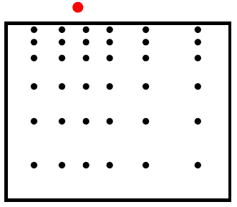
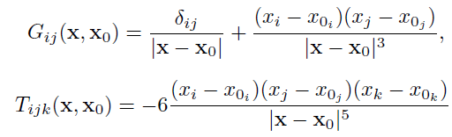
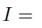
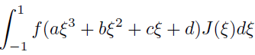
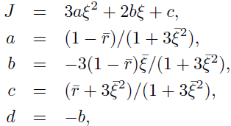
Nearly singular integral for lubrication
~0.8μm
Velocity field by BEM
RBC transmigrating splenic slit
Self-Adaptive Quadrature: Third Degree Polynomial Coordinate Transformation
Free-space Green’s function for velocity and stress
For example,
Do a polynomial transformation
where
Regular Gaussian Quadrature
Self-Adaptive Quadrature
Adjust integration points distribution
Coarse mesh: reduce computation cost
(J.C.F. Telles, Int. J. Numer. Methods Fluids, 1987)

Slide 13
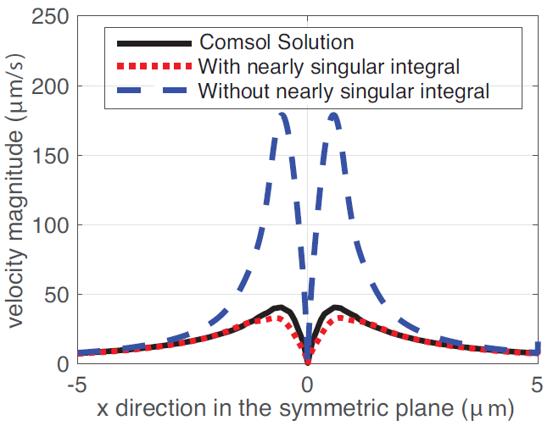
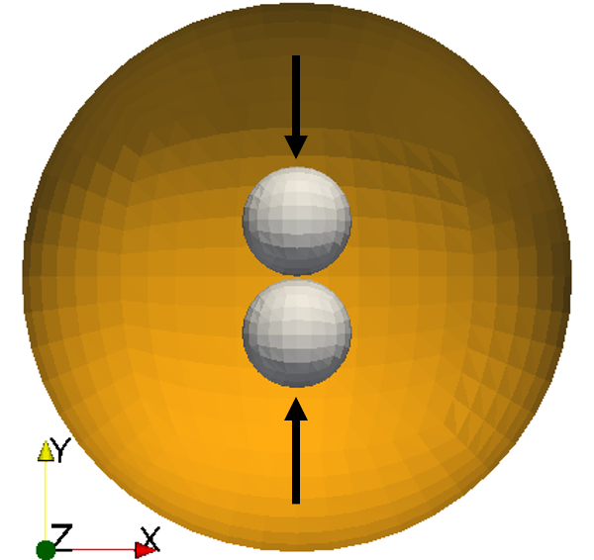
Validation of nearly singular integrals
Illustration of the problem
By considering the nearly singular interaction between the two small spheres, the velocity along x axis is much closer to the exact solution.

Slide 14
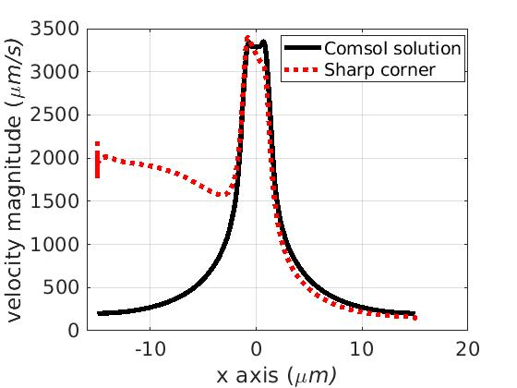
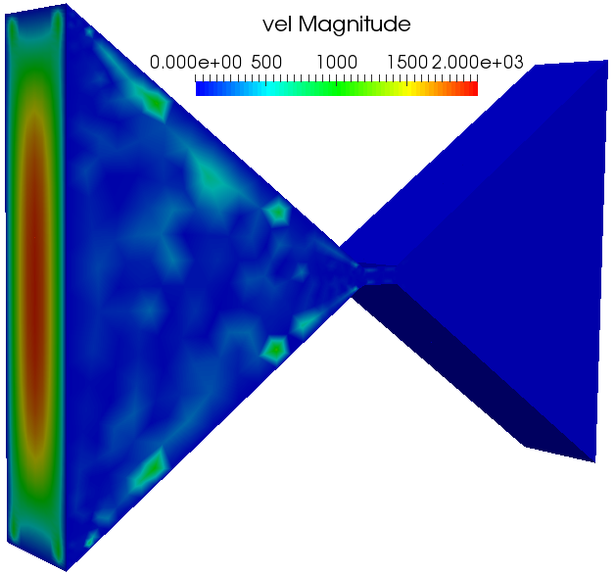
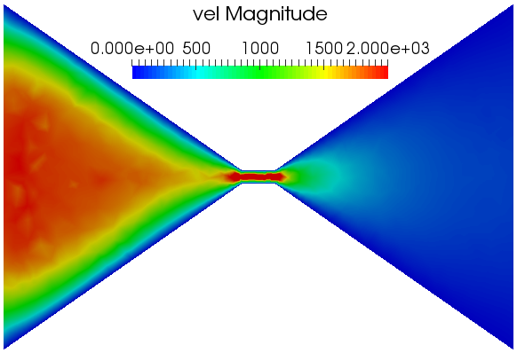
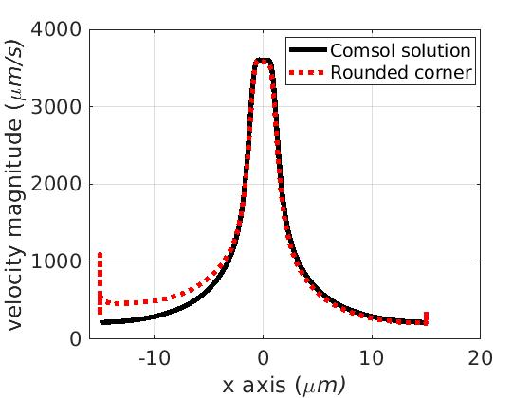
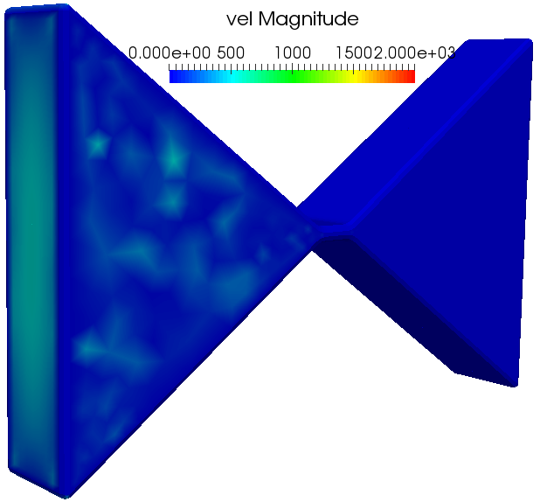
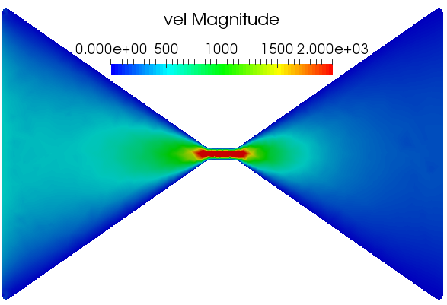
Sharp Corner Singularities
Sharp Coner
y
Velocity field by BEM
x
Smoothed Corner
y
x
Velocity field by BEM
Notes:
Two ways to solve this problem and we adopted both:
Singularity paper: refine the mesh at the sharp corners. We increase meshes at the corners.
In experiment (reality), never sharp corner. Rounding the sharp corners is not artificial, but in fact makes our numerical
Simulations more realistic compared with the experiments.

Slide 15
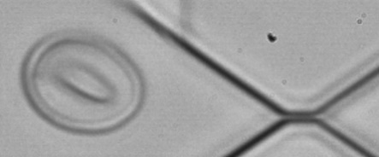
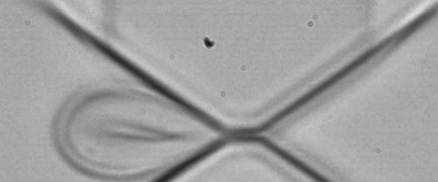
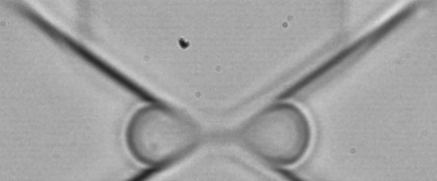







Validation of Cell Deformation and Transit Time against Experiments
Same Condition:
pressure of 831 Pa and same geometry of the channel
t = 0s
t = 0.0016s
t = 0.0076s
t = 0.0126s
t = 0.0176s
t = 0s
t = 0.0012s
t = 0.0072s
t = 0.0124s
t = 0.0156s
(P. Gambhire,
A. Viallat
et al., Small, 2017)
Notes:
We predict the tip formation. I will explain why the tip forms later on in the future work part.

Slide 16




















Distribution of Velocity Field
Cytoskeleton Shear Deformation
Bilayer-Cytoskeletal Interaction
Tension in the Bilayer
Notes:
Bilayer-cytoskeletal interaction:
Blue color means the bilayer and cytoskeleton try to dissociate. Maximum dissociation stress happens at the trading edge/leading edge/the tip
in the third snapshot.
Red color means they try to push together.

Slide 17



Validation of Cell Deformation and Transit Time against Experiments
Same Condition: pressure of 831 Pa and same geometry of the channel
t = 0s
t = 0.0016s
t = 0.0076s
t = 0.0126s
t = 0.0176s
t = 0s
t = 0.0012s
t = 0.0072s
t = 0.0124s
t = 0.0156s
Without Tip
(P. Gambhire,
A. Viallat
et al., Small, 2017)
With Tip
Notes:
We predict the tip formation. I will explain why the tip forms later on in the future work part.

Slide 18














Effect of Surface Area to Volume Ratio
A = 129.078um^3
V = 93.88um^3
Failed to pass through
A = 133.90um^3
V = 93.88um^3
A = 139.76um^3
V = 93.88um^3
A = 146.57um^3
V = 93.88um^3
A = 154.27um^3
V = 93.88um^3

Slide 19



Acknowledgement
NSF CBET-1706436
Collaborators:
Annie Viallat, Priya Gambhire, Emmanuèle Helfer (Aix Marseille Universite, France)
Wendy AlvarezBarrios, Siyuan Zhang (University of Notre Dame)
Zhangli Peng, Zhe Feng, Sebastian Sensale (University of Notre Dame)
Thank you!

